Slide 1
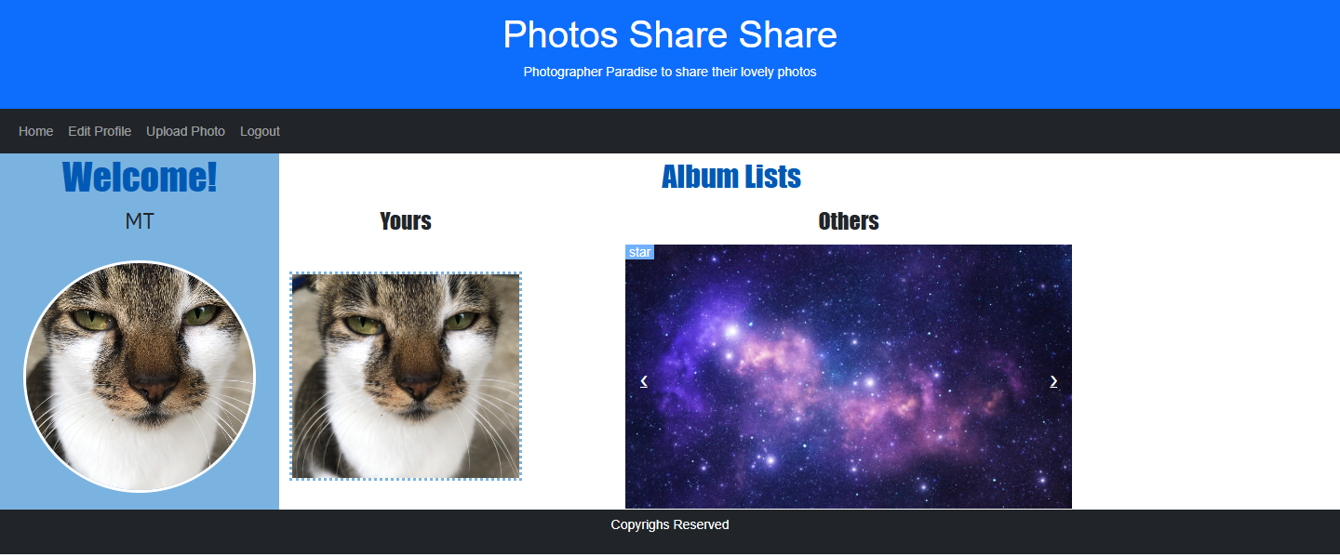
Album List
Layout Style
Easy-to-read
Energy
Layering
Colours
Font size and style
Parts
Left and right

Slide 2
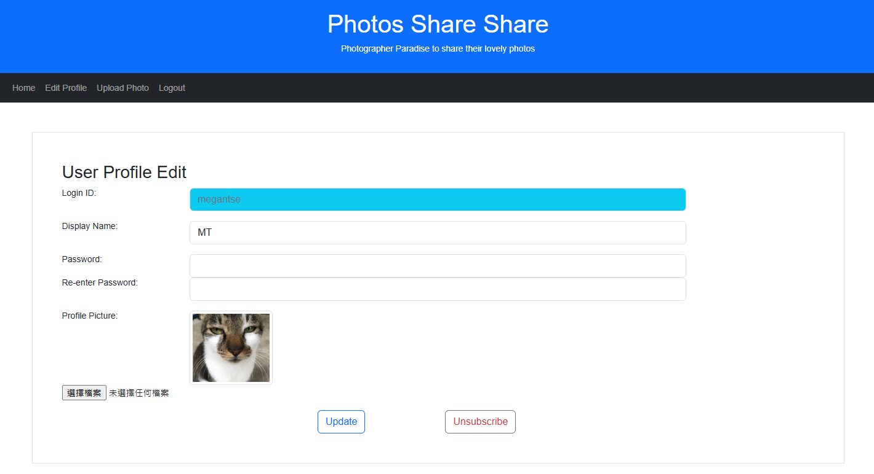
Album List
Left-hand side
“Welcome!”
User’s profile
Display name
Profile picture
Profile Pic
White border
Circle-shaped
Hyperlink
User profile edit

Slide 3
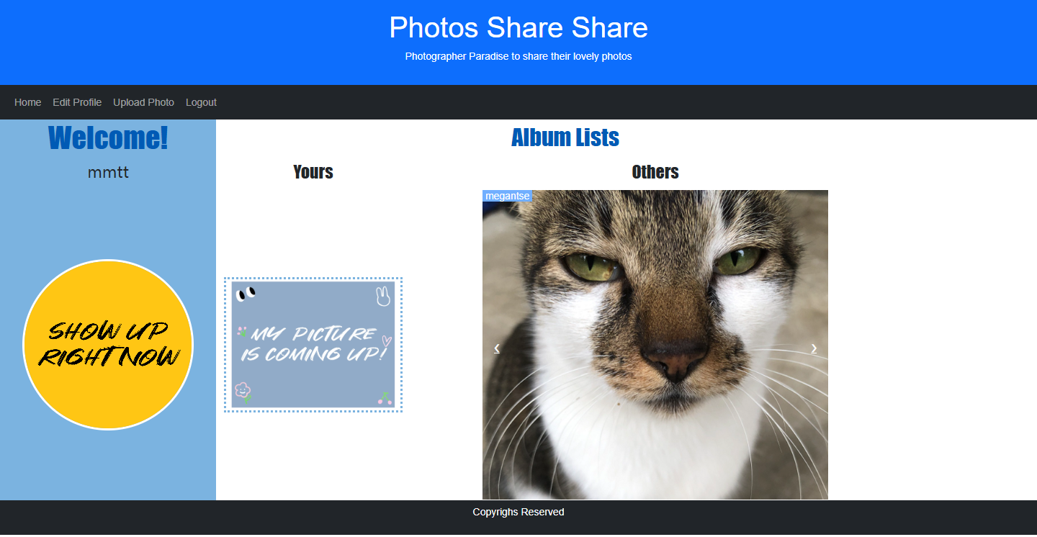
Album List
Right-hand side
Yours
Logged-in user’s album
Profile picture
Dotted border
Others
Other users’ albums
Profile picture
Go & back by hands
Yours / Others
Links to photo list

Slide 4
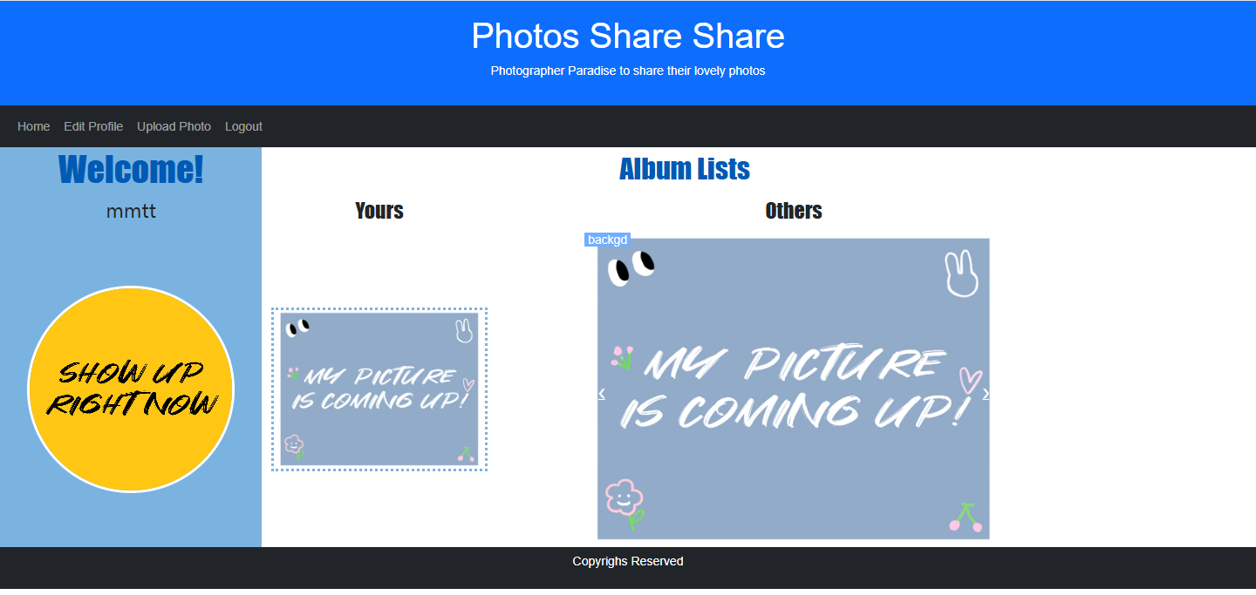
Album List
Both sides
Default images if no photo uploaded

